Slide 1
Computer Science Coursework 2026/27
Discussion
George Cooke

Slide 2


Idea #1
Todo Tracker
Track repeating todo list items,
  Have a table each for daily, weekly, and monthly repeats,
  Generate each item based on repeat schedule at the beginning of each day,
Print / email the itinerary of the day to the user at the beginning of each day,

Slide 3
Idea #1- Rejection Report
Todo Tracker
Overly simplistic,
  Can be done in a week,
No scope for sorting and searching algorithms,
Boring,

Slide 4
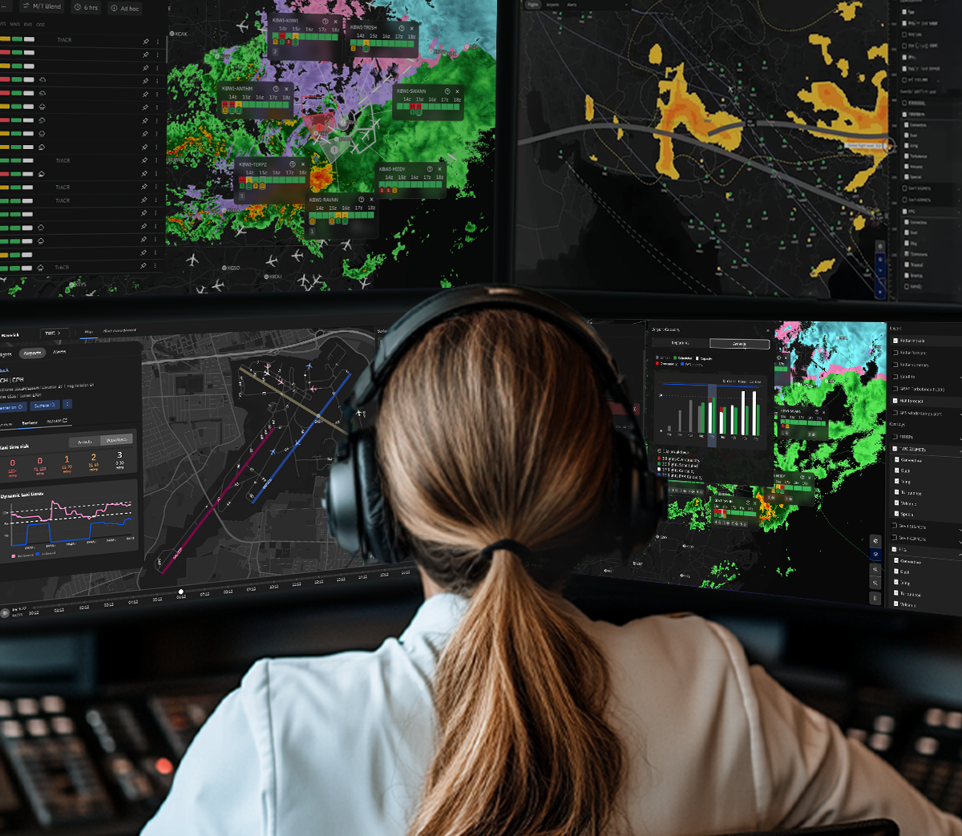
Idea #2
Airline Operations
Track the fleet of the airline,
Assign to routes,
Track maintenance schedules,
Manage delays,
Manage and assign crew,

Slide 5
Idea #2- Rejection Report
Airline Operations
No way to interact with the real world,
  Failures would have to be randomised,
  Gives unsavoury flavour of gamification,

Slide 6

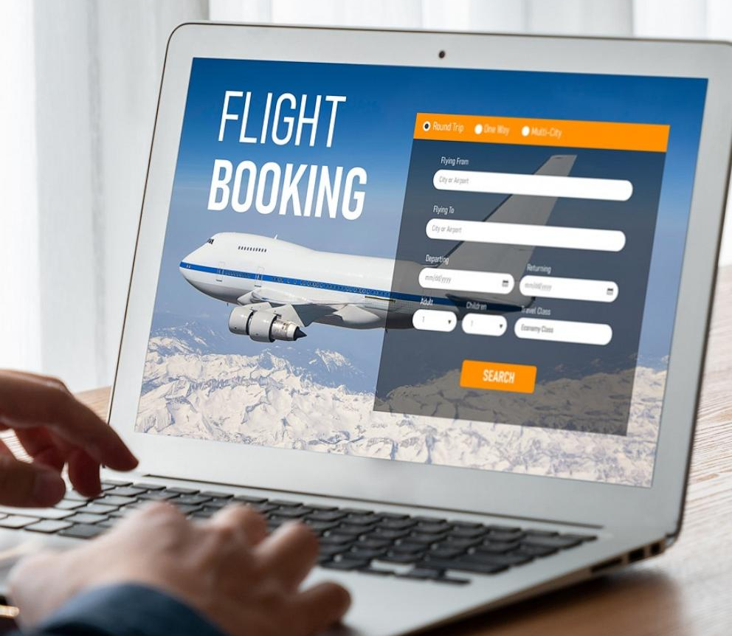
Idea #3
Airline Bookings
Create routes,
  Schedule for the future,
Passengers need to be able to book on to flights,

Slide 7
Thought Process
Todo List Tracker
Airline Flight Operations
Airline Booking System
British Airways Booking System
Fictional Airline Booking System

Slide 8

Meet The Client
Infinity Airways

Slide 9
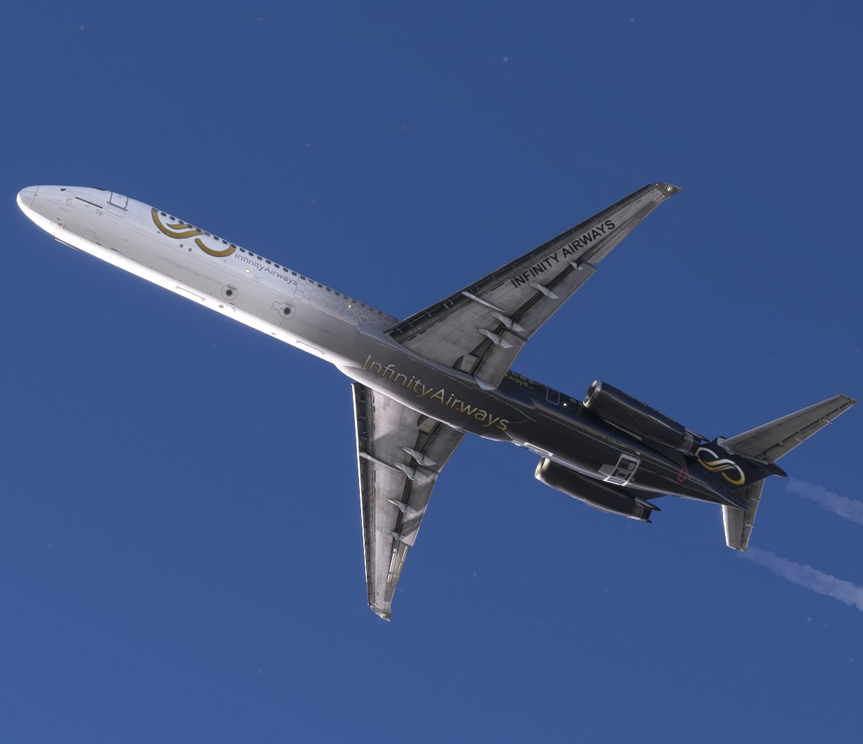
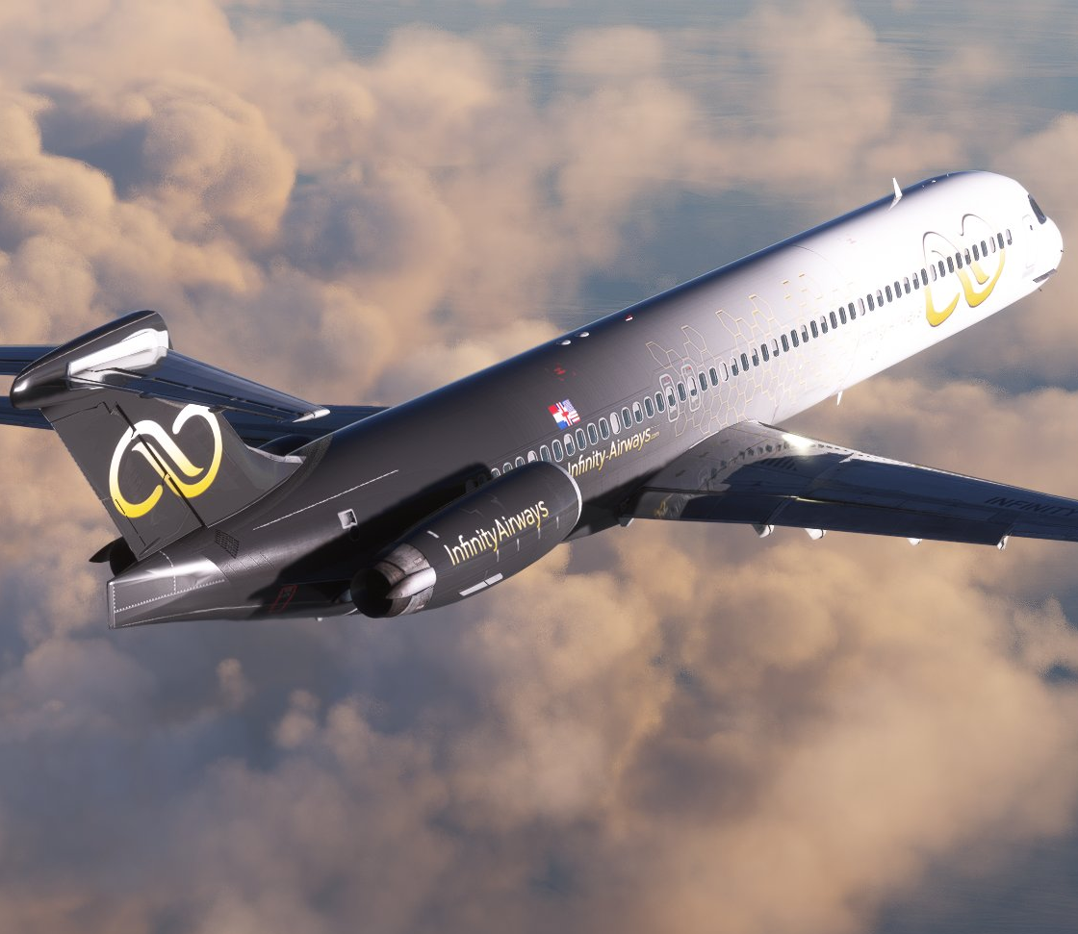
Infinity Airways
Overview
New airline,
  No existing system,
Targets the middle ground between private / chartered aircraft and high-end airlines,
Differentiates self through incredible attention to detail,
Luxury takes back seat as focus is drawn to destinations,

Slide 10
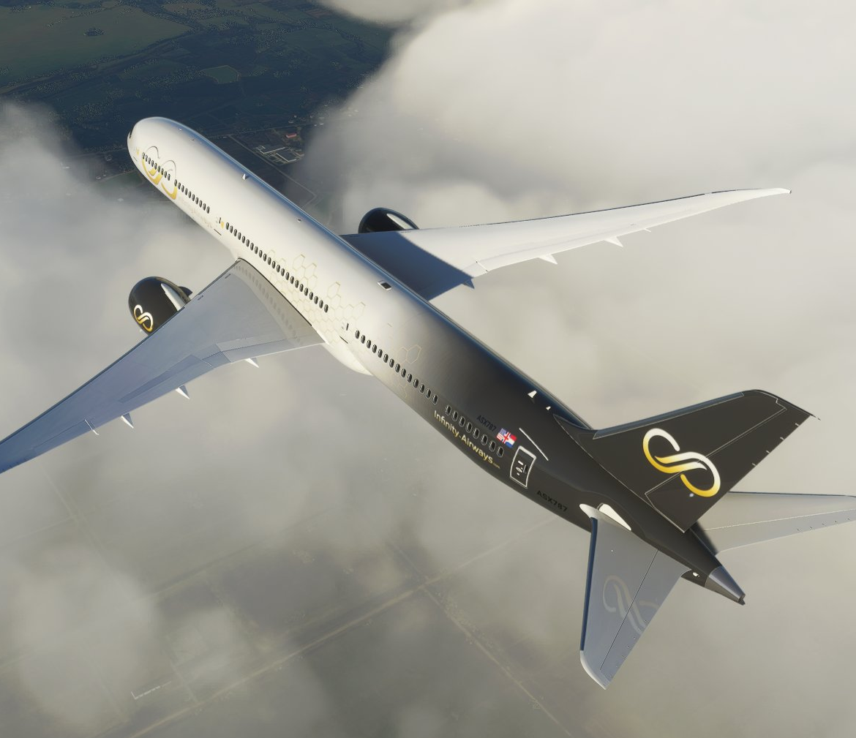
Infinity Airways
The Problem
Infinity Airways needs a booking system to allow passengers to book on to flights for specific dates. To do this, flight operations managers will have to be able to add the routes and schedules.

Slide 11
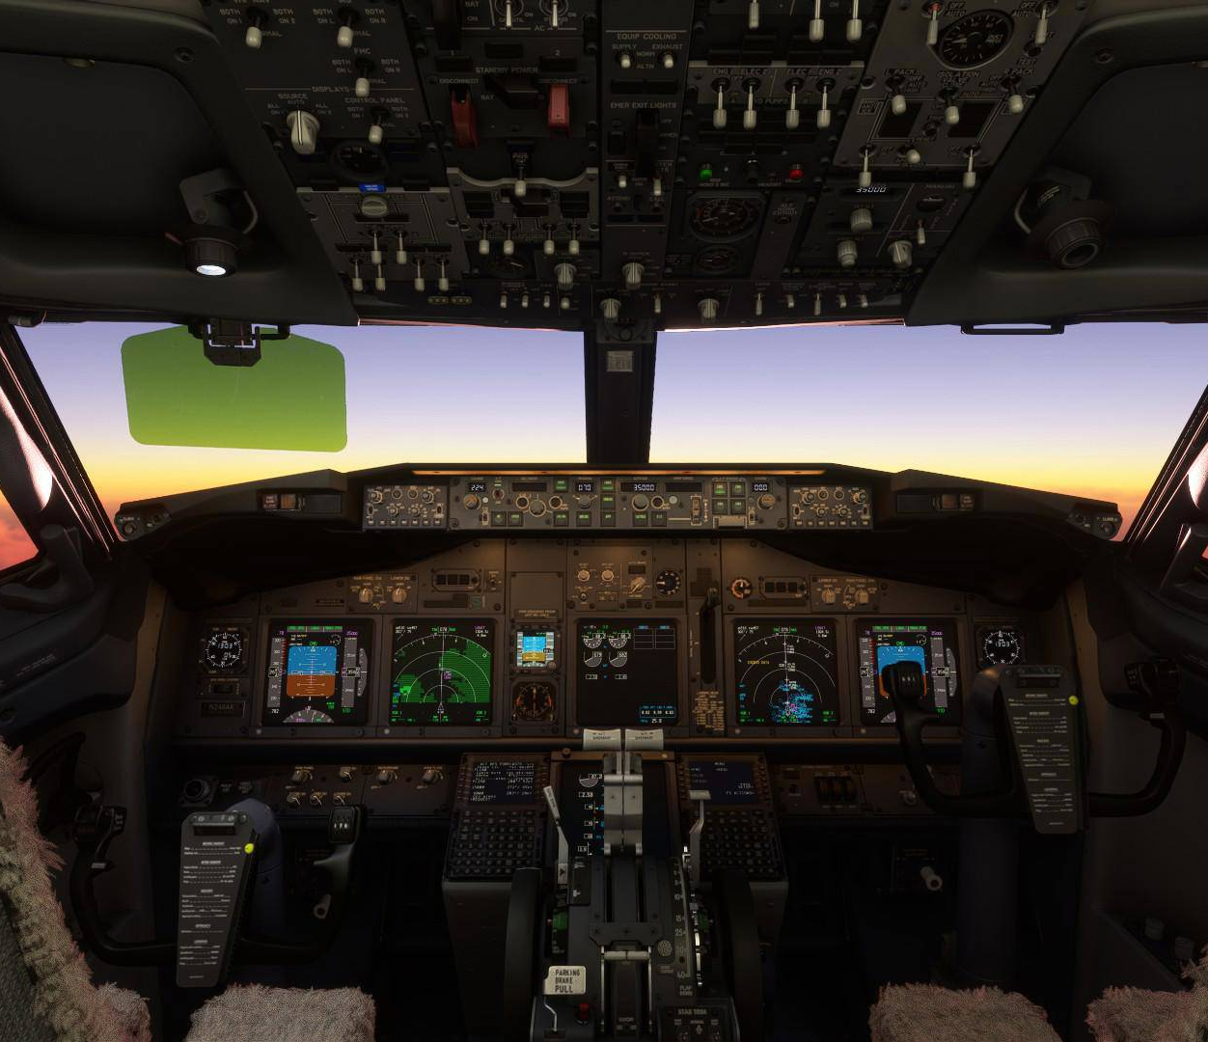
Infinity Airways
User Types
Passengers,
Flight operations managers,
Admin,
Check-in agents,
Gate agents,
Customer support representatives,

Slide 12



Name: Jessica
Age: 46
Industry: Banking
Income: £150,000+ pa
Jessica is in the banking industry and is subject to incredibly demanding hours. She gets very little time to herself and is taking an extended weekend away in a tropical location for some rest and relaxation.
Name: James
Age: 20
Industry: Early Retired
Net Worth: £25,000,000+
James made his fortune from selling his startup at a young age. He now spends his time partying and thrill-seeking. He frequently charters an aircraft for large groups but doesn’t find it worth it for just himself.
Name: Peter
Age: 63
Industry: Business Executive
Income: £3,000,000+ pa
Peter has spent his life climbing the corporate ladder and is slowly preparing himself for his retirement. Like Jessica, he has little spare time. He most frequently travels to North America and Asia for business trips.

Slide 13
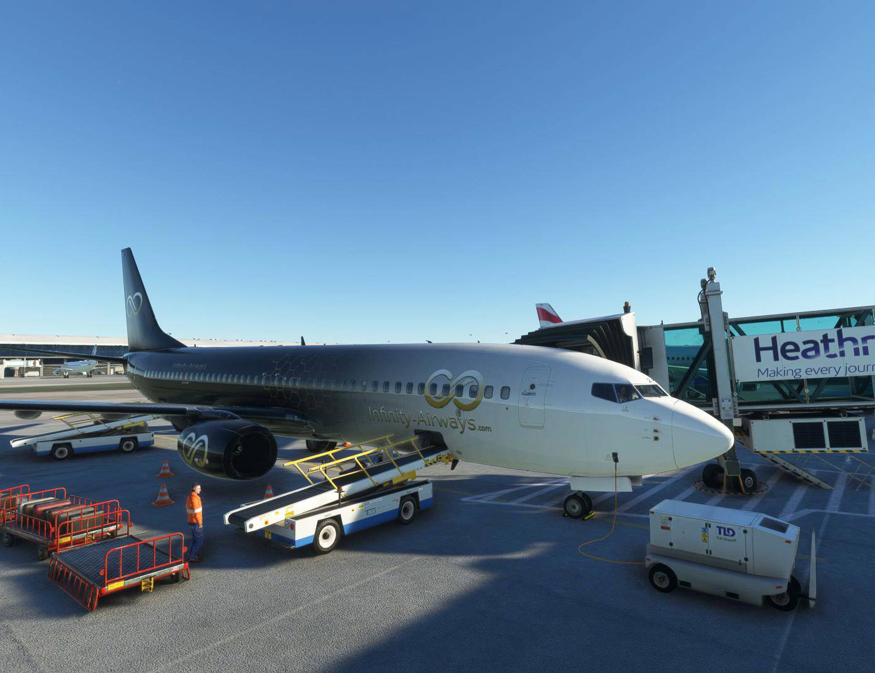
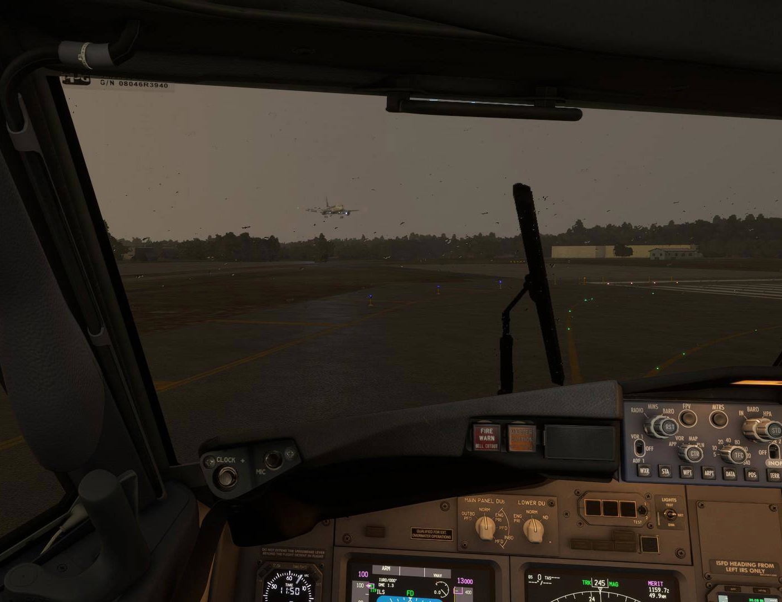

Aims & Objectives
Threshold
Flight operations managers can add flights,
Passengers can book on to flights,
GUI,
Use a database containing 4 tables in 3NF,

Slide 14
Aims & Objectives
Target
Secure user login,
Flight scheduling,
Search for flights,
Implement separate account types for each user type,
Flight operations managers can see flight / route performance over time,
Booking passengers can give the passport details of the people in their group,
PDF boarding passes,

Slide 15
Aims & Objectives
Stretch
Email validation and boarding passes,
Stripe test API for payments,
Articles for destinations added by flight operations managers,
Advanced search for nearby flights using quick sort,
Dynamic pricing,
Autofill passenger details,
Different aircraft types have different seat maps,

Slide 16
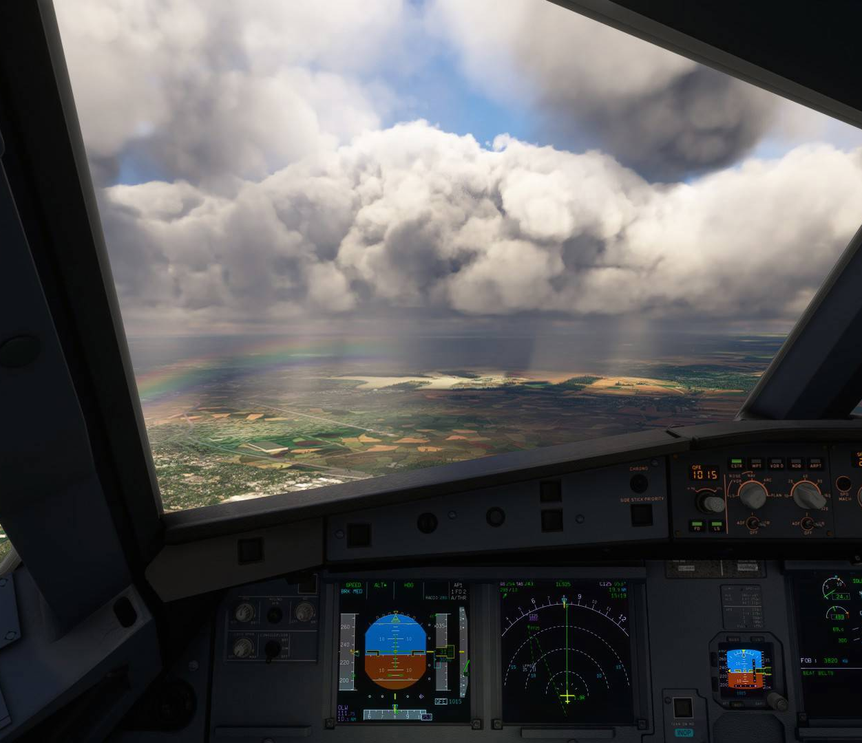
Limitations
Will not coordinate aircraft locations,
Risk of server strain,
Will not coordinate crew schedules,
No mobile app,
Will not handle any real money,
Requires data protection audit,
No information about profitability of flights,

Slide 17
Thank You

